Slide 1
If-Condition using Python
Edwin James John
Aspirant of Full Stack Web Development (V406)

Slide 2
If-Condition has four types: if-statement, if-else statement, nested-if statement, if-elif-else statement.

Slide 3
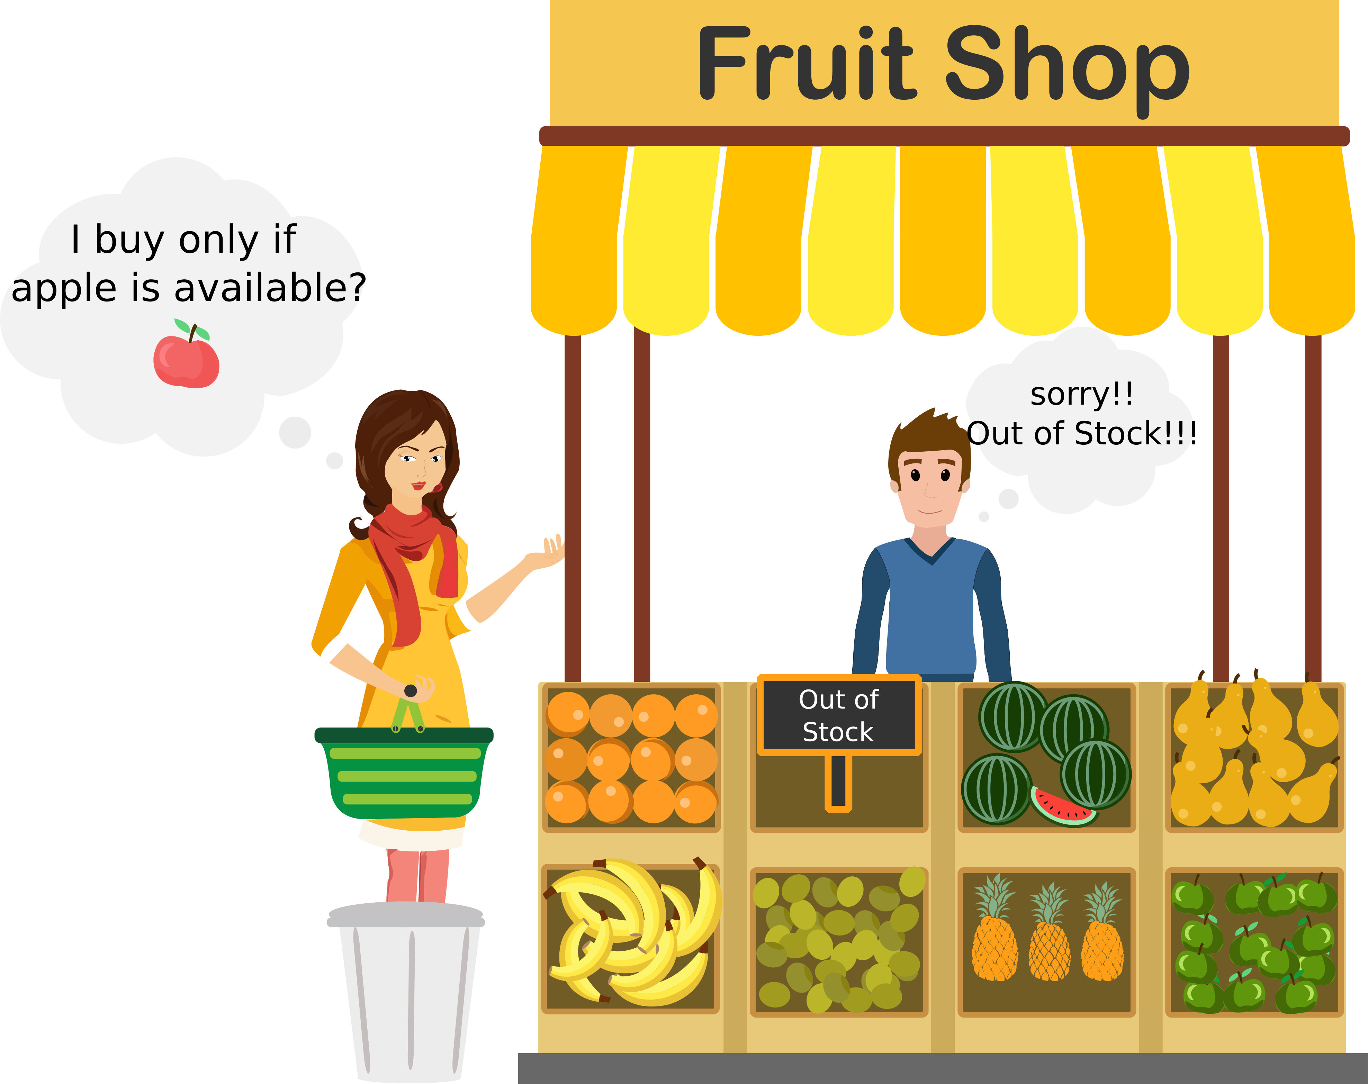
If-Statement
It is used to decide whether a certain statement or block of statement executes or not.
Syntax:
If condition:
statement 1 (#if condition is true or not)
statement 2
Example:
A = int(input(“Enter the required values”))
If (a<10):
print(“Here you go”)
print(“Out of stock”)

Slide 4
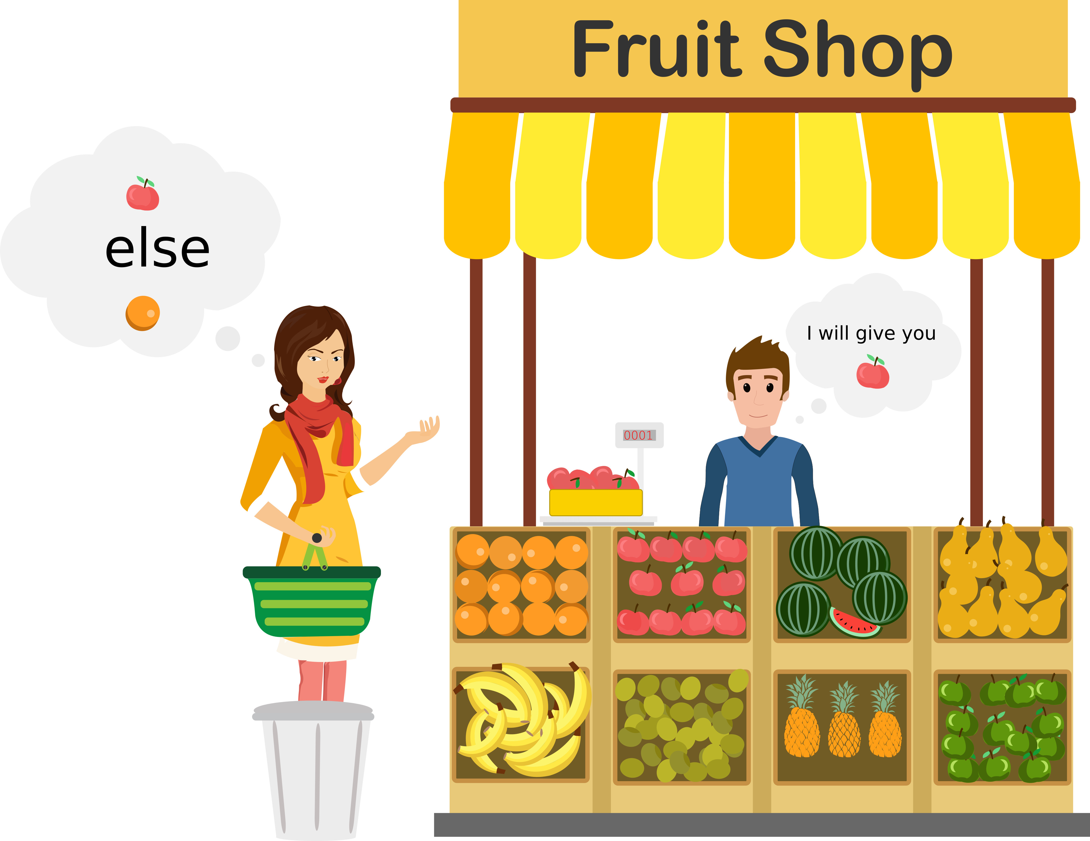
If-else Statement
Syntax:
If condition:
statement 1 (#if condition is true)
else:
statement 2 (#if condition is false)
Example:
A = int(input(“Enter the required values”))
If (a<10):
print(“Here you go Apple”)
Else:
print(“Here you go Orange”)
It is executed as the condition present in the if statement is false after calling the statement which is not the block.

Slide 5
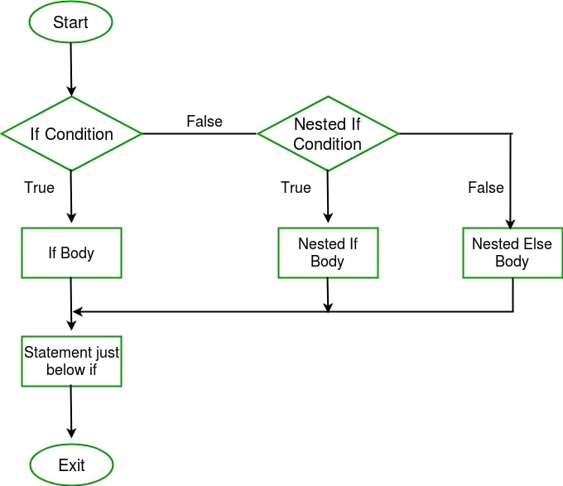
Nested-If Statement
Example:
marks = int(input("Enter your marks:"))
if(marks>60):
print("C Grade")
if(marks<50): print("Maximized Marks")
else:
print("Sorry, its actually B grade")
Syntax:
If condition:
statement 1 (#if condition is true or not)
if condition:
statement 2
(#if condition is true)
else:
statement 3
(#if condition is false)
It is used to execute statement one by one, until you get the output.

Slide 6
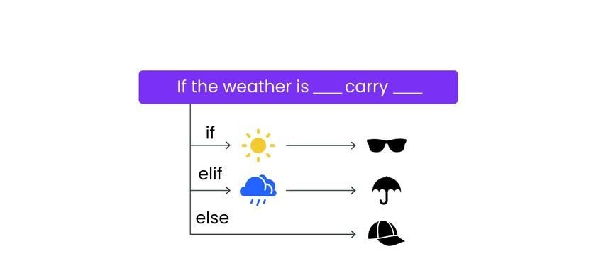
Example:
a = int(input("Enter the unit of apple:"))
o = int(input("Enter the unit of orange:"))
s = int(input("Enter the unit of strawberry:"))
if(a>10 and o<10): print("Here you go, I have packed your apple")
elif(o>10 and a<10): print("Here you go, I have packed your orange")
elif(s>10 and a<10): print("Here you go, I have packed your strawberry")
else:
print("We are out of order")
If-elif-else Statement
If statements are executed from the top down. As soon as one of the conditions controlling the if is true, the statement associated with that if is executed and the rest of the ladder is bypassed. If none of the condition is true, then the final else statement will be executed.
Syntax:
If condition:
statement
elif condition:
statement
.
.
.
.
else:
statement

